Slide 1
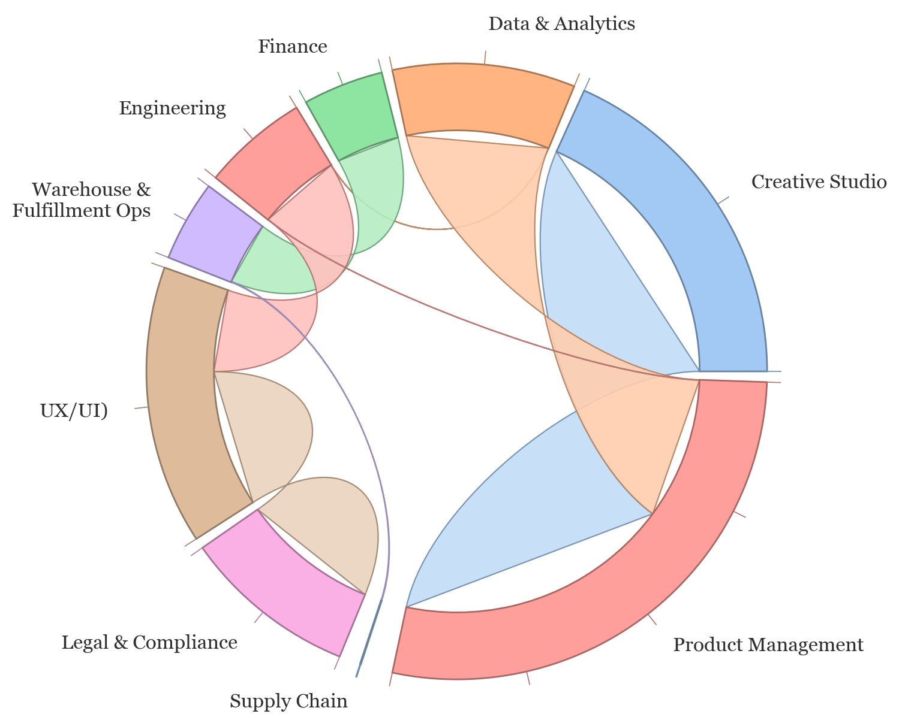
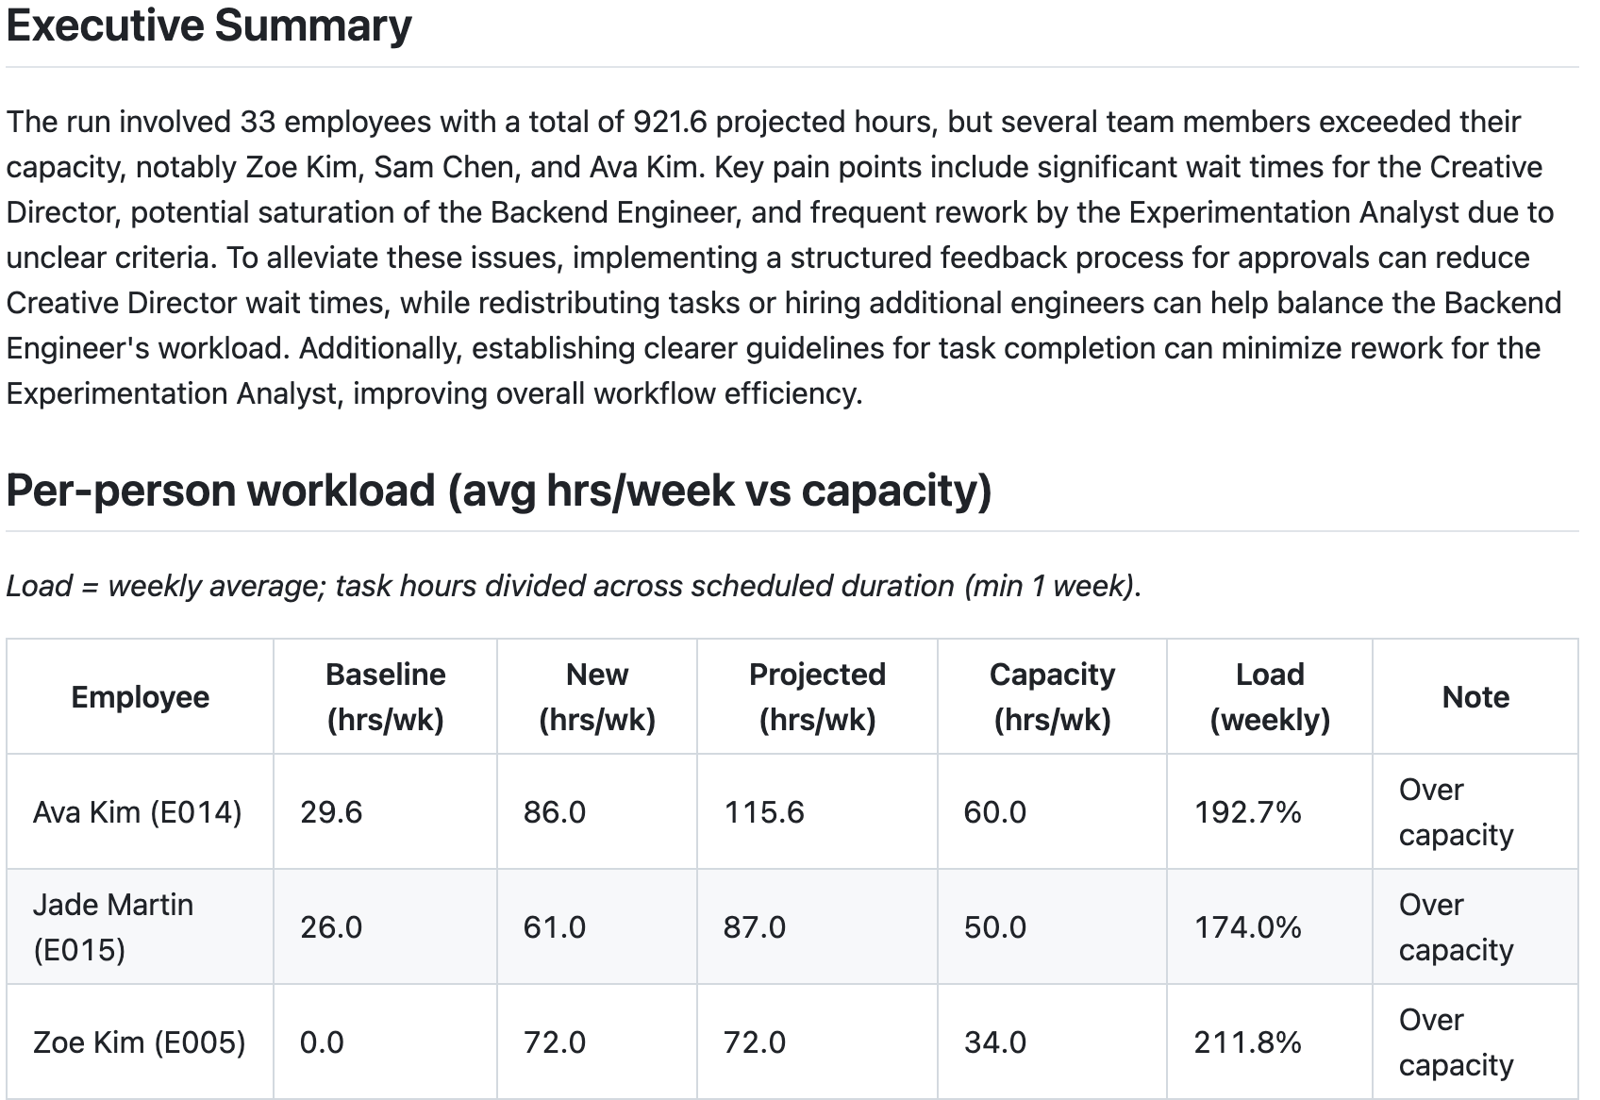
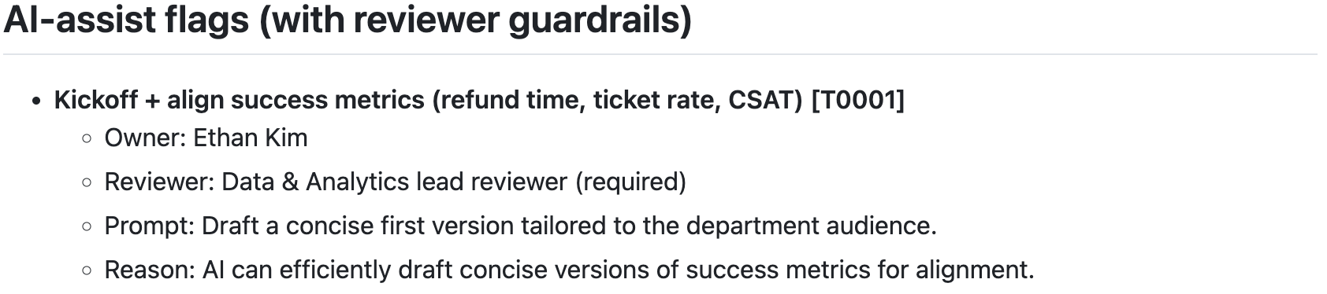
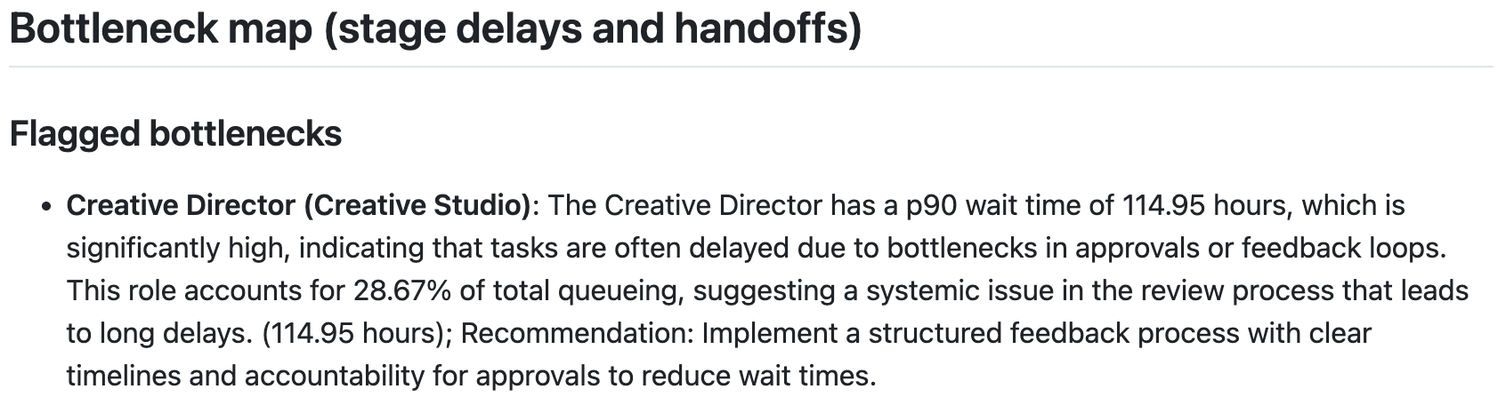
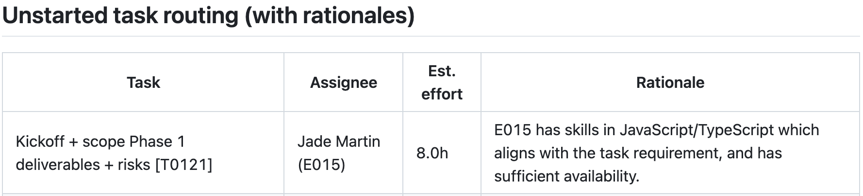
An Agentic Project-Management Tool for Cross-Functional Teams:
Streamlining workflow through bottleneck analysis and AI-powered optimization
Tiffanie Ng
IPHS 391 Frontiers of AI (Fall 2025) Kenyon College
Abstract
Data
Results
Project management apps center around tracking tasks but in reality, setbacks come from system-level dynamics (handoffs and review gates, or constrained specialists with overloaded schedules), which quietly compound until nothing ships on time.
This work presents an agentic project-management system that turns routine operational data (tasks, assignments, handoffs, etc) into manager-ready outputs:
skill- and capacity-aware task assignments,
automated bottleneck detection from event logs, and
human-in-the-loop AI-assist recommendations.
We evaluate our MVP using a synthetic dataset built with ChatGPT, mimicking cross-functional collaboration in a mid-sized e-commerce company. The data illustrates realistic departments, projects, tasks, and event logs in which the algorithm intentionally encodes six delay patterns and handoff structures for benchmarking.
As an MVP, the current interface is minimal (CLI and static report outputs). Future work will add calendar integration, dynamic project/task updating, continuous re-evaluation of workflow efficiency, and a web interface + Slack/Teams chatbot for intuitive day-to-day use by real teams.
DATA GENERATION — We used a hybrid generation strategy, where Python code decided IDs, timestamps, availability patterns, and event simulation, and an LLM was used to generate richer projects with associated tasks.
Event log generation emphasizes realistic work patterns, including clustered bursts of activity, weekends and idle gaps, and multi-step handoffs across roles.
WHAT WE EVALUATE — Performance is scored by how well the system can produce useful managerial insight from limited inputs:
Can it uncover bottlenecks from event logs alone?
Do task assignments respect employee availability while reducing skill mismatch?
Are AI recommendations constrained to low-risk and/or human-reviewable tasks?
WHAT WE FOUND — The bottleneck detector successfully identifies and interprets repeated handoff loops, queue delays, and late-stage approval gates, but struggled with the more subtle task misassignment delay.
Workload summaries highlight overloaded individuals and teams, clarifying where delays originate.
Assignment outputs consistently prioritize better skill fit and available capacity, avoiding allocating work to already saturated roles.
All AI recommendations were limited to low-risk assistance, focusing on tasks with explicit human review.
DATA TABLE OVERVIEW
employees (id, name, department, role, skills[], max_hours, timezone)
availability (employee_id, date, hours_free)
projects (id, name, description, deadline, priority)
tasks (id, project_id, name, skill_needed, est_hours, assignee, start, due, status)
events (task_id, type [start/end/handoff/queue], timestamp, from_assignee, to_assignee)
Figure 1: An overview of the structure of data in the synthetic dataset.
Figure 3: Chord diagram mapping the workflow illustrated in the synthetic dataset. Full reports can be found in the GitHub cited.
BOTTLENECKS — Six common workflow bottlenecks with distinct, measurable signatures are explicitly encoded into the event logs to test how well they can be detected and explained by the system (see Figure 2).
Conclusion and Future Work
EMBEDDED BOTTLENECKS | IDENTIFIED?
Analytics backlog caused by over-reliance on a small specialist team, leading to 24–96h queue delays. | Yes
Creative approval loops with repeated back-and-forth handoffs and long waiting periods. | Yes
Engineering interruptions with mid-task handoffs, late completions, and blocked tasks without terminal events. | Yes
Vendor-dependent delays seen in prolonged 72–168h silence periods in operations and supply chain work. | Yes
Late finance/legal reviews leading to 36–96h approval delays and clarification loops near deadlines. | Yes
Initial task misassignment 20% of the time, causing skill mismatch and corrective handoff after 6–24h. | No
This work illustrates the utility in the data that teams already have. Even as an MVP, our simple agentic infrastructure leverages these standard project artifacts to uncover hidden delays and identify opportunities for process optimization. Several extensions would move our system closer to real-world deployment:
Dynamic project/task updating and continuous re-evaluation of workflow as events occur.
Calendar integration to reflect real availability.
User interfaces including web dashboards and Slack/Teams bot for intuitive day-to-day use.
Smarter task assignment from learning assignment weights through outcomes instead of heuristics.
Introduction
THE PROBLEM — The core challenges in collaborative work emerge from coordination and transitions as work moves between people, and are not captured by traditional tools that solely measure task execution. In cross-functional settings:
  ownership is often unclear across teams,
  specialists are constrained and overloaded,
  tasks bounce between reviewers, and
  late-stage review/compliance gates further delay delivery.
Because most project management systems track what needs to be done instead of where work is stuck, these frictions are often invisible until deadlines slip.
WHAT’S THE FIX? — Our system analyses employee data and availability, project and task requirements, and event logs of how tasks move between people. Using these signals, it produces actionable reports that provide:
DIAGNOSES: employee workload overviews, average wait-time metrics, process analyses (supported by chord diagrams) that highlight where work is stalling
SOLUTIONS: clear task-assignment plans that reduce overload and misallocation, flagging low-risk AI-assist opportunities to accelerate tedious work, and interpretable bottleneck narratives with recommended fixes.
WHY SYNTHETIC DATA? — Real company workflow logs are inaccessible due to privacy/policy constraints, but using a simulated organization also has its advantages. The synthetic dataset allows us the controlled injection of known bottlenecks to benchmark our detection logic and evaluate whether our system can suggest a plausible story about why work slows down and how to fix it.
Figure 2: Table displaying the six bottlenecks embedded in the synthetic test data, and the results of app bottleneck analysis.
Ethics Statement
Methodology
Model was tested on only synthetic data. AI was used as a part of the app, as a tool for data generation, and for strictly drafting code and text.
SYSTEM DESIGN — The application is implemented as an agentic pipeline, where each agent operates over shared structured data and is responsible for one stage of project planning, diagnosis, or recommendation:
Load structured data tables detailing employees, availability, projects, tasks, and events,
Resource Allocation Agent assigns unstarted tasks by balancing skill compatibility and capacity constraints.
AI Opportunity Scout flags low-risk tasks where AI assistance can safely accelerate work.
Bottleneck Detector analyzes event logs to compute workflow delays and identify coordination hotspots.
Workflow Recommender translates these patterns to recommendations of process interventions.
OUTPUT: A consolidated, manager-facing report summarizing task assignments, workload risk, detected bottlenecks, and AI-automation opportunities
References
[1] https://github.com/tiffani3ng/agentic-project-management/blob/main/
reports/human_readable_summary.md
[2] Abad, Z. S. H., Karras, O., Schneider, K., Barker, K., and Bauer, M. 2018. Task interruption in software development projects: What makes some interruptions more disruptive than others? In Proc. 22nd Int. Conf. Evaluation and Assessment in Software Engineering (EASE ’18), 122–132.
[3] Karimi, H., Sarvari, H., Edwards, D. J., Chan, D. W. M., and Olawumi, T. O. 2024. Deploying bottleneck management strategies for ameliorating critical delays in building construction projects: A case for developing country of Iran. Systems 12, 6, Article 195. DOI:https://doi.org/10.3390/systems12060195
[4] Bull, D. 2025. Operational bottlenecks and workforce efficiency: A quantitative evaluation using the theory of constraints in healthcare. Zenodo 13, 60–78. DOI:10.5281/zenodo.15585196.
Figure 4: Collection of excerpts from the consolidated report generated in a sample run. Full reports can be found in the GitHub cited.

